Slide 1

MAR 653 Project – Team1 Marketing analytics Data : Danhumby – Complete Journey
Carlton Everett
Christopher Birsner
Pedro Pereira
Tamilselvan Tamilmani

Slide 2

About the Data

Slide 3
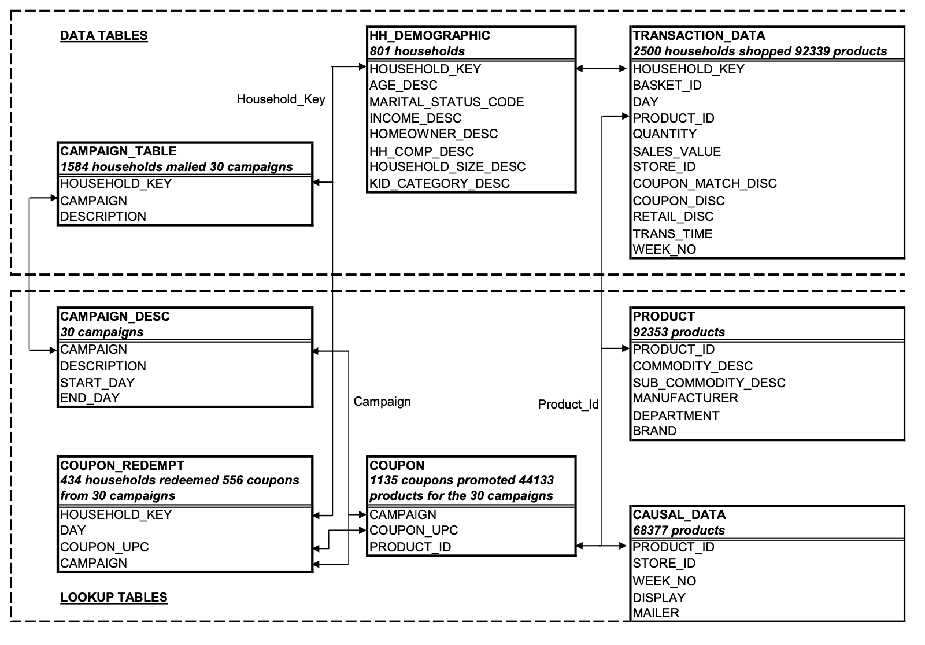

Slide 4
Assumptions & Constraints
Only 1/3 of the population has demographic data
No Campaign Target information, like which demography was targeted
Actual date was not specified, but from the days, we saw one leap year involved, so we assumed 2008 and 2009

Slide 5
Business Questions
How many customers are spending more over time? Less over time? Describe these customers.
Of those customers who are spending more over time, which categories are growing at a faster rate?
Of those customers who are spending less over time, which categories are they becoming less engaged with?
Which demographic factors appear to affect spend of the customer? Engagement with certain categories?
Is there evidence to suggest that direct marketing improves overall customer engagement?

Slide 6
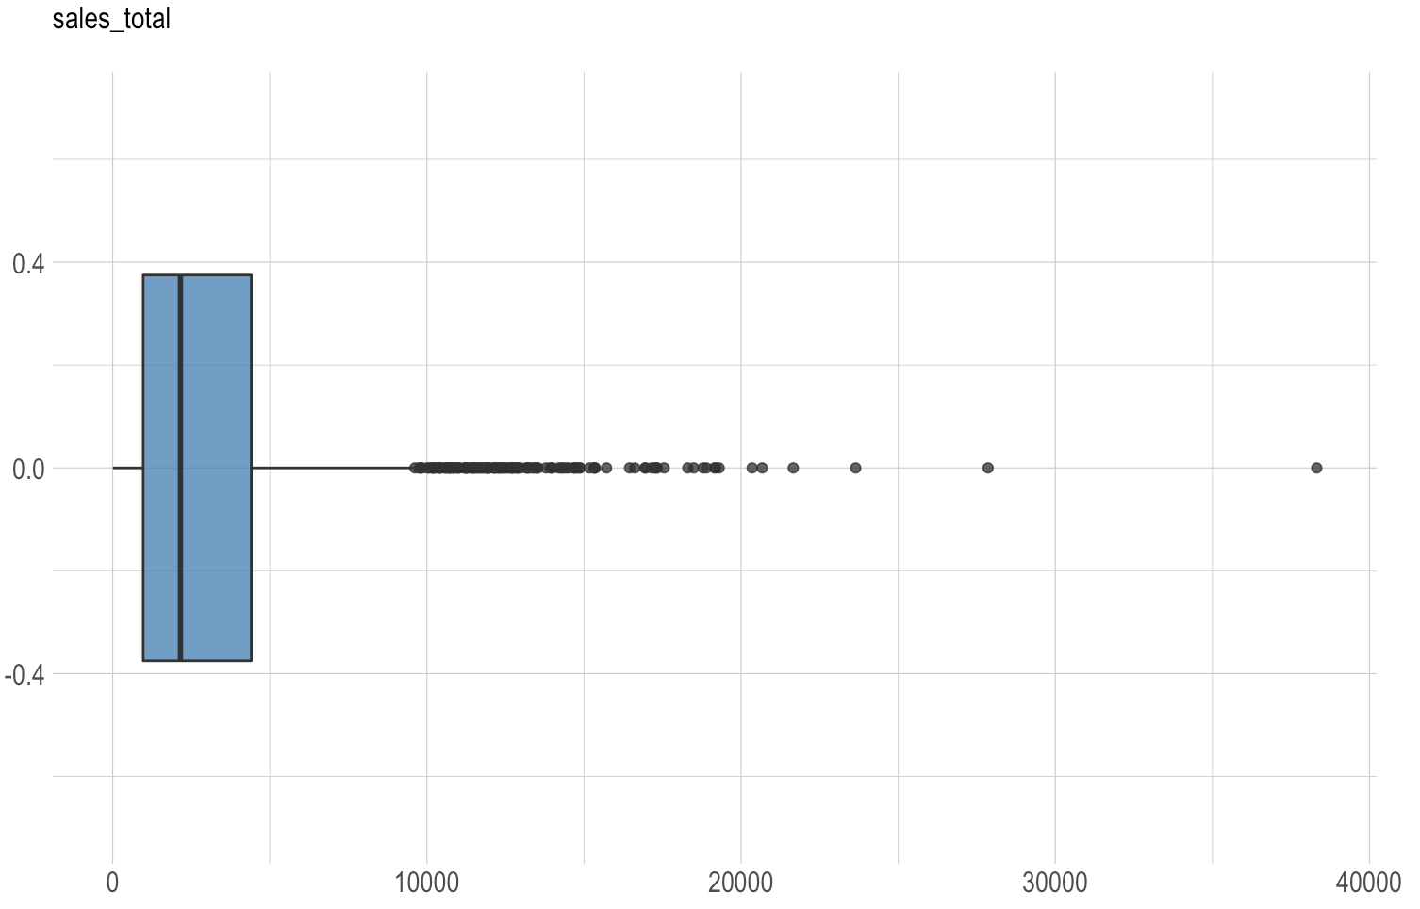
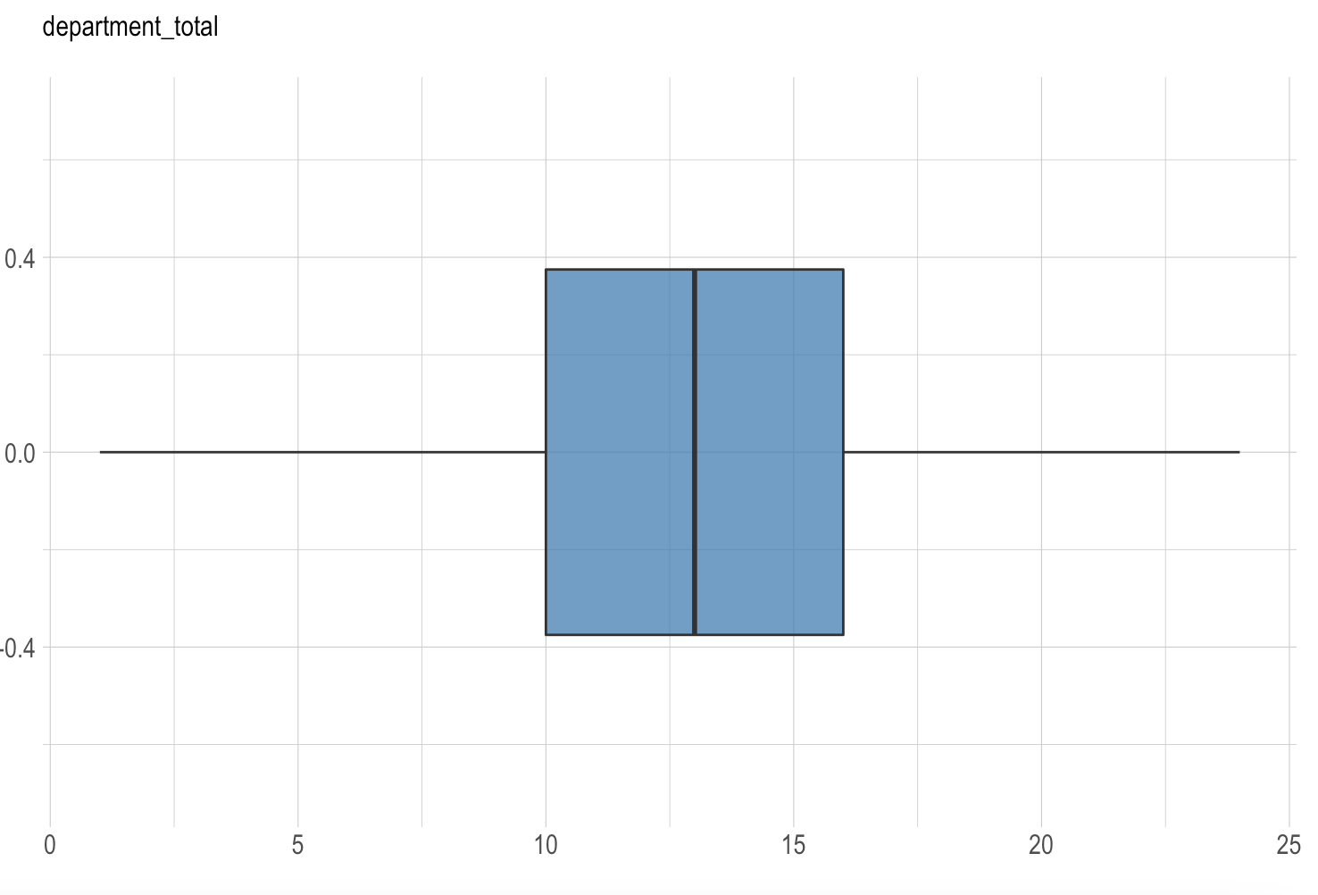
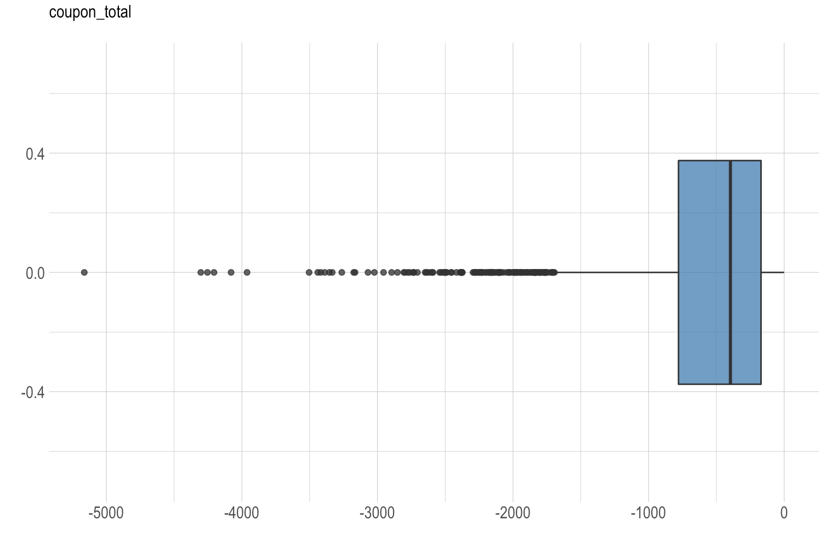
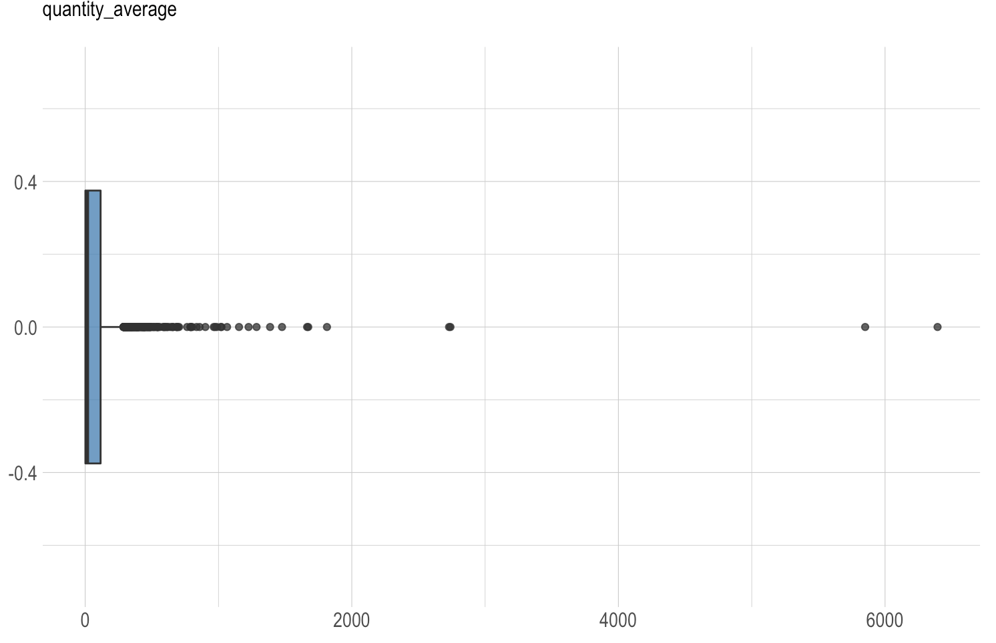
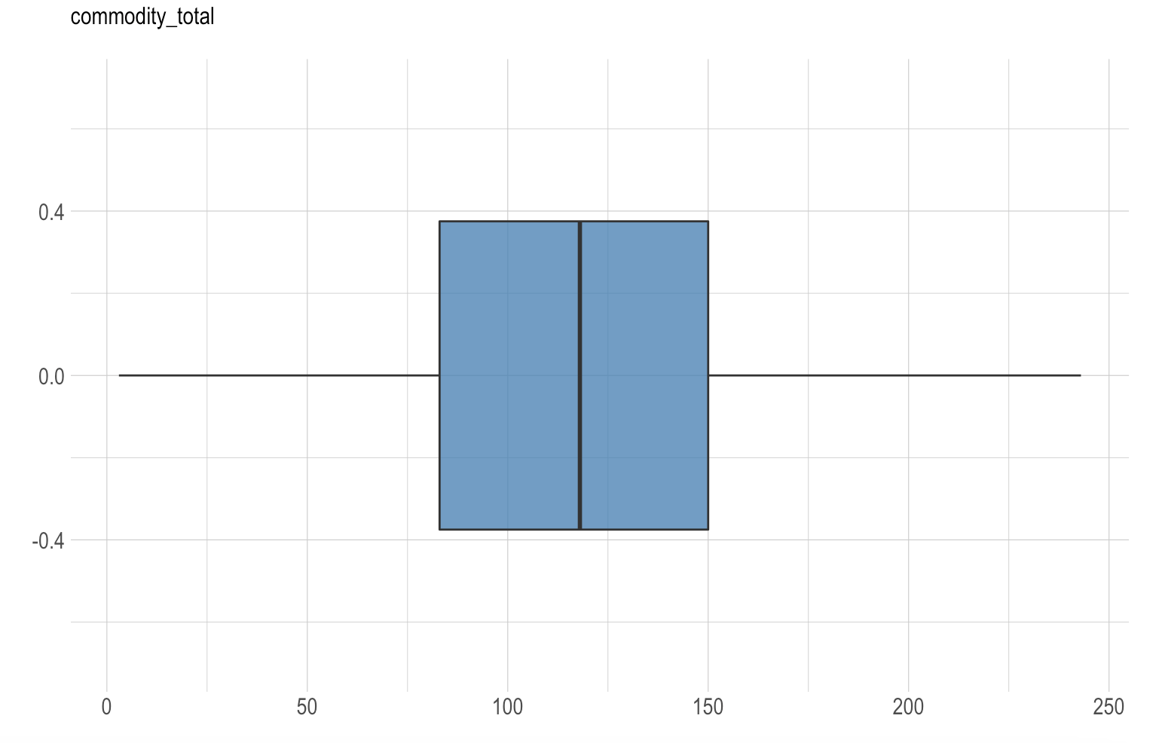
EDA
$3200 Average Sales Per Household
$580 in coupon per Household
Our Customers shops in 13 different departments and 246 unique items on Average

Slide 8
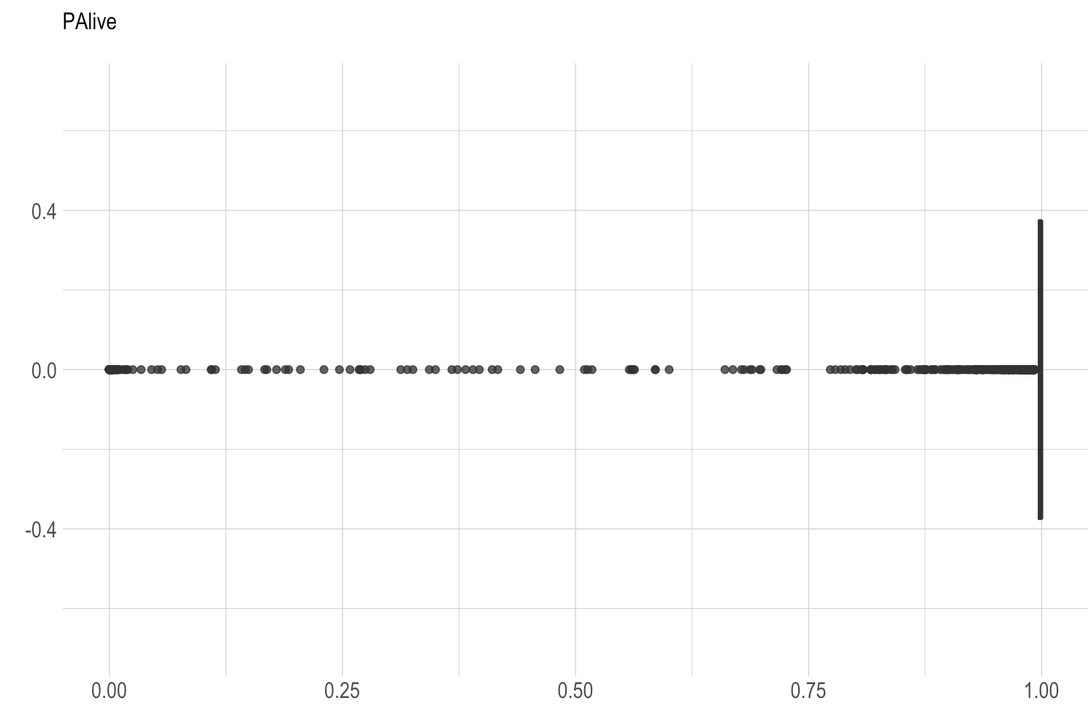
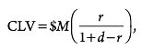
Why CLV
We are trying to explain retention in forward looking manner, so decided to use Customer Lifetime Value
From our Palive, we can see most of our customer are alive means not churning a lot

Slide 9

Q1 - How many customers are spending more over time? Less over time? Describe these customers
Notes:
& now to get into the questions starting with question 1: How many customers are spending more over time? Less over time? We’ll have describe these customers.

Slide 10
Spending Over Time by CLV
50% of the customers account for more than 80% of sales
Notes:
-To answer this question, we used the customer lifetime value calculation. In running the CLV, we split it by median to get a clearer picture. We found that 50% of the customers made up over 80% of the sales over time while the remaining 50% made up less than 20% of sales. When I say customers, I mean households. These households come in many different forms.

Slide 11

Shopper Descriptions
Customers Who Spend Less Over Time
Customers Who Spend More Over Time
Homeowners with above average income with at least one child
Households in the 35-54 age range
Households with 3 or more individuals
Renters with average to lower income
Senior citizens (Age starting at 55)
Household with incomes of $15k-$24k
Notes:
- For high spending customers, this includes homeowners with at least one child in the house making an average to above household income.
-It also include shoppers in the 35-54 age range. These are households with more than one inhabitant that could include children as well as elders.
-it also included households with at least 3 or more individuals.
-Low spending customers based on the data include renters with average to lower income who tend to have no kids. It also includes senior citizens starting at age 55 who we infer to be on a fixed income based on the data.
- Low spending households also include those with incomes that fit into the $15k-$24k range.

Slide 12
Shopper Descriptions
Notes:
And here are the charts that we based the observations on. I’ll now pass it to Chris to over question 2.

Slide 13
Q2 - Which demographic factors appear to affect spend of the customer? Engagement with certain categories
Notes:
Chris

Slide 14
Impact Of Demographic Factors
Attribute | Estimate | Pr(<|t|)
UNIQUE_PRODUCTS | 7.2607 | 2.60E-09
COUPON_TOTAL | -3.6107 | < 2e-16
COUPON_AVERAGE | 4144.4757 | < 2e-16
NATIONAL_BRAND_PERCENT | 2719.8957 | 0.000143
SALES_MAX_ITEM | 7.9788 | 8.47E-08
INCOME- UNDER 15K | -801.6689 | 0.061441
INCOME-15 to 24K | -898.1868 | 0.028446
INCOME-175 to 199K | 1625.3237 | 0.01681
INCOME-250K+ | 1599.802 | 0.020054
HOMEOWNER UNKNOWN | -529.8628 | 0.007137
AGE 25-34 | 677.1057 | 0.046242
Those who are in the age range of 25-34 and/or have a household income of more than $170,000 are likely to have a positive impact on the overall CLV.
Meanwhile, those whose income between 0-24K are likely to have a negative impact on the overall CLV.
Buyers are brand oriented and buy a lot of variety of products
Higher CLV households use coupons
Adjusted R-squared: .749
Notes:
Chris

Slide 15
Q3 - Of those customers who are spending more over time, which categories are growing at a faster rate
Notes:
Pedro

Slide 16
High CLV Customer Demographic
Attribute | Estimate | Pr(<|t|)
UNIQUE_PRODUCTS | 6.6999 | 1.31E-08
COUPON_TOTAL | -3.6844 | < 2e-16
COUPON_AVERAGE | 5290.9394 | < 2e-16
NATIONAL_BRAND_PERCENT | 1742.6464 | 0.01719
SALES_MAX_ITEM | 8.8785 | 2.07E-10
INCOME-15 to 24K | -812.3055 | 0.04386
INCOME-175 to 199K | 1872.5139 | 0.00377
INCOME-250K+ | 1794.4271 | 0.00612
HOMEOWNER - PROBABLE | -1208.6105 | 0.03303
HOMEOWNER - RENTER | -566.9762 | 0.07977
HOMEOWNER - UNKNOWN | -474.2786 | 0.01497
High Income Range
Buyers are brand oriented and buy a lot of variety of products
Buy Costly Items
Higher coupon Usage
Adjusted R-squared: .7821

Slide 17
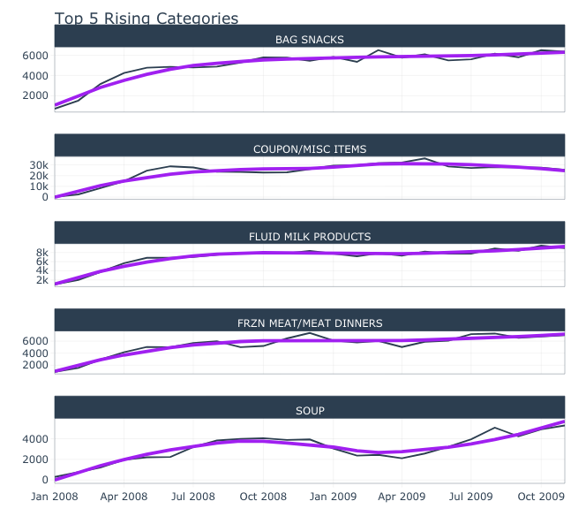
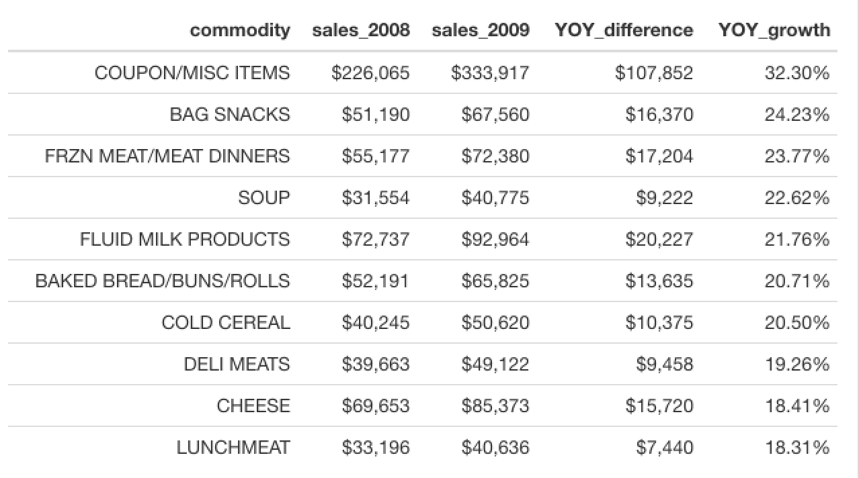
Growing Categories for High CLV Customers

Slide 18
Q4 - Of those customers who are spending less over time, which categories are they becoming less engaged with

Slide 19
Low CLV Customer Demographic
Attribute | Estimate | Pr(<|t|)
Intercept | 1495.1124 | 6.74E-02
UNIQUE_DEPARTMENTS | -91.9068 | 0.00917
COUPON_TOTAL | 0.8535 | 0.01564
NATIONAL_BRAND_PERCENT | 1742.6464 | 0.01719
AGE_DESC25-34 | 514.1712 | 0.08658
AGE_DESC35-44 | 460.9471 | 0.08064
HOUSEHOLD - ADULT KIDS | 780.2086 | 0.06934
HOMEOWNER - UNKNOWN | -291.9957 | 0.0432
Significant Intercept
Homeowners
1 Adult Kid
Do not buy costly items
Adjusted R-squared: .2286
Out of 1250 households , 1143 get dropped due to missing data in the demography

Slide 20
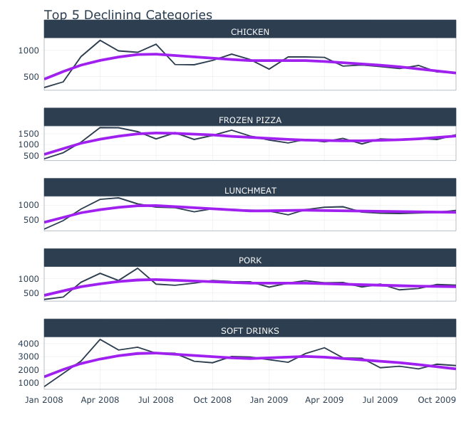
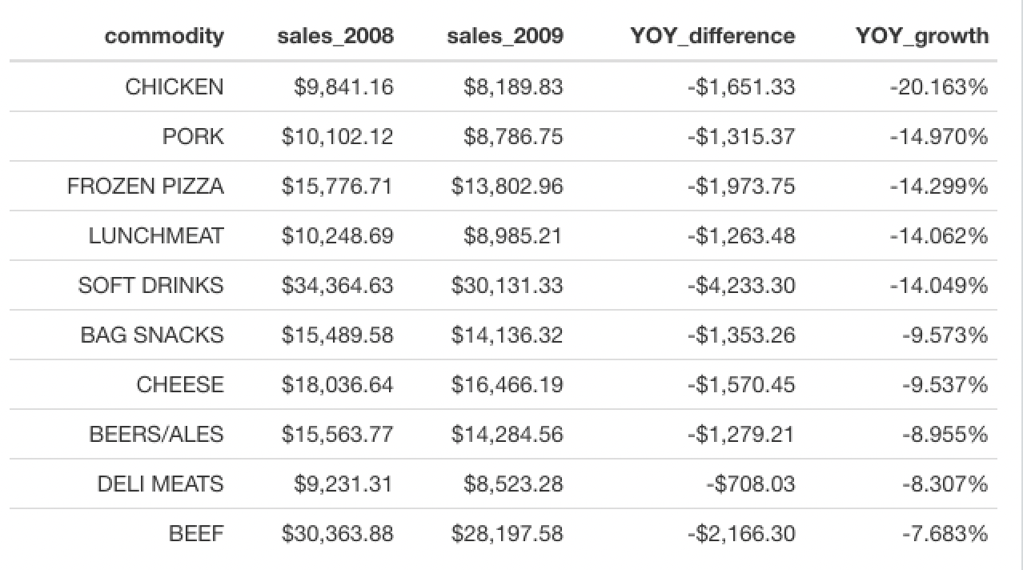
Shrinking Categories for Low CLV Customers
Notes:
Pedro

Slide 21

Q5 - Is there evidence to suggest that direct marketing improves overall customer engagement

Slide 22
log(clv) ~ TypeA_count + TypeB_count + TypeC_count
Marketing Campaign impacts customer CLV and so the engagement
All 3 Campaigns was targeted towards high CLV customers
 | CLV > Median |  | CLV < Median
 | Estimate | Pr(<|t|) | Estimate | Pr(<|t|)
(Intercept) | 7.834585 | 2.00E-16 | 5.760429 | 2.00E-16
Campaign TypeA count | 0.05488 | 1.78E-08 | 0.159305 | 0.00081
Campaign TypeB count | 0.150043 | 2.00E-16 | -0.14217 | 0.09266
Campaign TypeC count | 0.146353 | 7.82E-15 | -0.008556 | 0.9666
Adjusted R² | 0.4534 |  | 0.0006 | 0.0006
Notes:
Tamil

Slide 23
Log (clv)– (campaign) for CLV>Median

Slide 24
QA

